Slide 1

Reboot Your….
Clark Sell.info
Web Evangelist
Microsoft Corporation

Slide 2
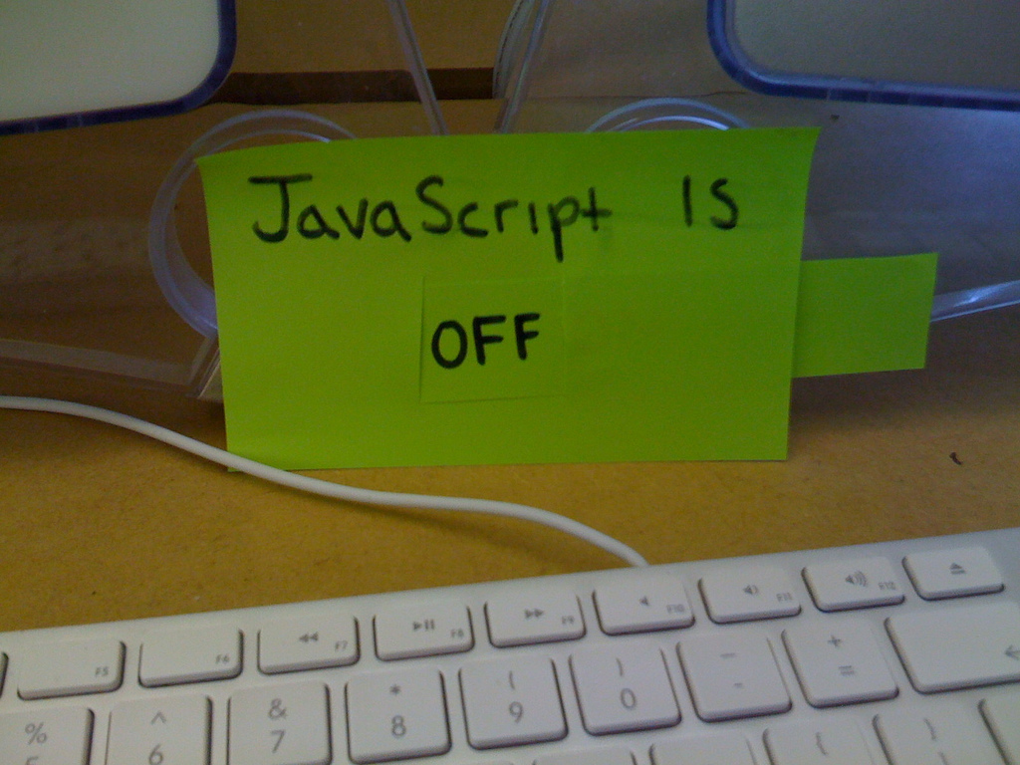


why JavaScript
DOM Interaction
Behavior
Validation
AJAX
Friends don’t let friends do_postback
Notes:
http://www.flickr.com/photos/itssamuel/3387737094/sizes/l/in/photostream/

Slide 3




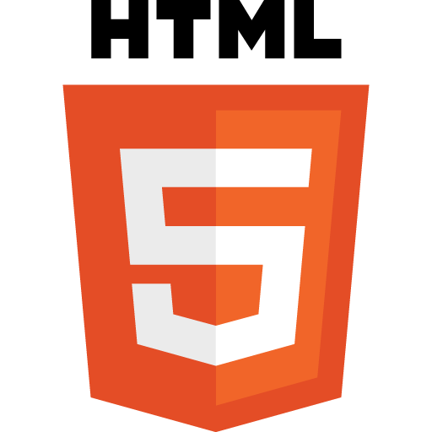


why now?
Notes:
http://www.flickr.com/photos/itssamuel/3387737094/sizes/l/in/photostream/

Slide 4
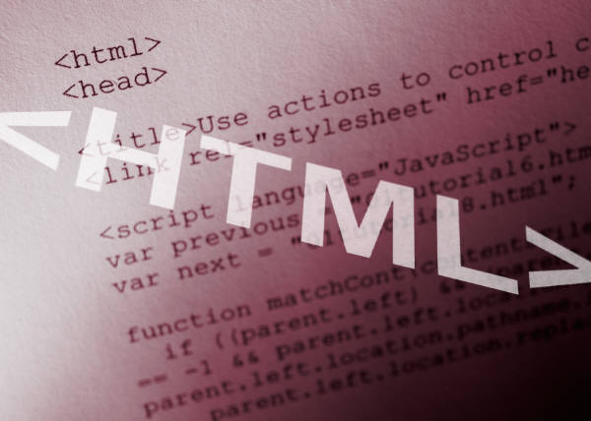
Notes:
It’s the language of the modern web….

Slide 5
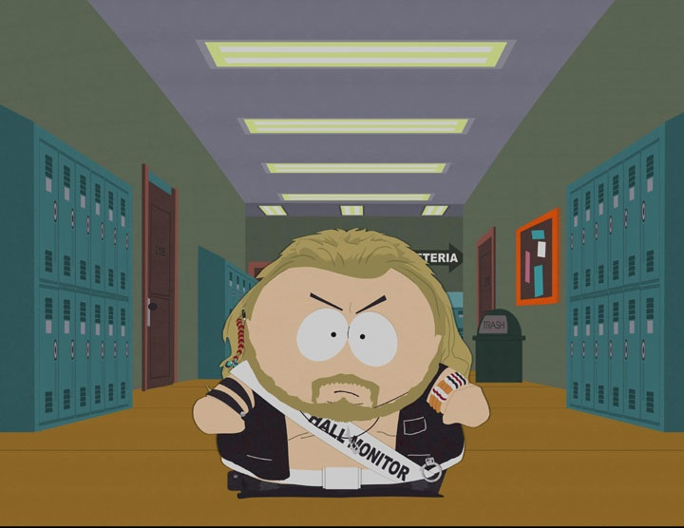
Your Hall Pass Has Expired!!!
Notes:
You can’t ignore it anymore.

Slide 6
“ JavaScript is a language that most people don’t bother to learn before they use.
Most people feel like they should be able to program in JavaScript without any knowledge at all”
- Douglas Crockford
Notes:
Think about that..
For the most part you can do so but there are enough bad parts to make things dag
http://yuiblog.com/crockford/

Slide 7

Why??
Notes:
Fast, Simple, Sleek

Slide 8
What is JavaScript ECMAScript
!== Java
!== C#
=== Dynamic Language
=== Functional Language
=== Simple but extremely expressive and powerful
Recently updated to ECMAScript 5 in December of 2009
Notes:
What does ECMA, its no longer
Computer Man Association
http://www.ecma-international.org/
http://www.ecma-international.org/publications/files/ECMA-ST-ARCH/ECMA-262,%203rd%20edition,%20December%201999.pdf
http://www.ecma-international.org/publications/standards/Ecma-262.htm

Slide 9

Agenda
The Modern Web
Language Fundamentals
Tooling
Resources

Slide 10

the modern web

Slide 11
Notable Events
XMLHttp
AJAX
Browser Maturity
Focus on Security
People matured
Awesome frameworks and libraries, such as jQuery
Over time its become accepted.
Notes:
In the years following 1999, the dynamic nature of web applications was taking another leap forward, and it all started with the XMLHttp object that Microsoft introduced in with Internet Explorer 6.
The XmlHttp object is an ActiveXObject that Microsoft shipped with Internet Explorer as a way to enable rich experiences in Outlook Web Access (OWA). OWA was designed to be a close representation of Outlook (a desktop application) and, as such, required the use of features (drag and drop, partial page updates, etc) that weren’t natively supported in web applications. The XmlHttp object enabled rich functionality be enabling the web browser to send small XML snippets back to the server using JavaScript and asynchronous Http requests, all without refreshing the currently loaded page.
Soon thereafter, Mozilla an Opera reverse engineered the XmlHttp object and shipped functionality in their own browsers, enabling other, non-Microsoft sites and applications to leverage the ability to send and receive small snippets of xml and update portions of a page without the typical screen flash seen on most web applications to date.

Slide 12

“Modern”, “Unobtrusive” JavaScript
There really is no “such thing”.
Techniques have matured
Clean
Simple
Fast
Tested
Notes:
Fast, Simple, Sleek

Slide 13
Unobtrusive Style
CSS
( Style )
Html
( Structure )
Notes:
No doubt you’ve heard of CSS. If so, you know that CSS is powerful because it encourages the separation of style and structure in web sites. That separation takes the form of css files that are used to add styling to our Html pages, without the need for in-line styling of pages.

Slide 14
Unobtrusive JavaScript
Script
( Behavior )
Html
( Structure )
Notes:
Similar to CSS, jQuery operates under the principle of creating clean separation of web elements. Rather than style and structure, as with CSS, jQuery works under the principle of “Unobtrusive JavaScript,” which encourages the separation of behavior and structure. As with CSS, you should put as little script in your Html pages, and certainly not on elements themselves.

Slide 15
JavaScript
<a id="myId" href=“http://csell.net” onclick=“alert(‘hello’)”>
</a>
inline Bad
separation Good
var myElement = document.getElementById("myId");
myElement.onClick( function () {
alert('hi');
});
Notes:
[BDS] Perhaps show the inline here as well and swap inline and separation in the list

Slide 16

the Result
Testable
Separation of Concern
Performance
Reuse
Versioning
Notes:
[BDS] Perhaps show the inline here as well and swap inline and separation in the list

Slide 17
fundamentals

Slide 18

getting Started
Objects
Equality
Object Literals
Functions
Closure
Prototypes

Slide 19
objects
No Classes
Everything is an object expect for primitive types
Everything is declared globally
Namespace Namespace Namespace

Slide 20
Variables
Type defined at assignment
Best to define all variables right away
Scoped to function when using var
foo; // Global & undefined
var foo2; // Scoped & undefined
var foo2, foo3;
var foo3 = null; // null
var foo4 = “foo4”; // typeof string

Slide 21
== !== ===
== type coercing
=== equality
0 == ‘’ // true
0 == ‘0’ // true
false == ‘0’ // true
null == undefined // true
All would have evaluated as expected with ===
Notes:
http://enterprisejquery.com/2010/10/how-good-c-habits-can-encourage-bad-javascript-habits-part-2/

Slide 22
=== false
false
null
undefined
“” ( empty string )
0
NaN ( Not a Number )
var isFalse;
if ( !isFalse ) {
console.log("Hi");
}

Slide 23
Functions
function FooBar(){
//Do Something
};
var name = function FooBar(){
//Do Something
};
var name = function(){
//Do Something
};

Slide 24
Functions
( function () {
//Do Something
})();
( function ($) {
// Do Something
})(jQuery);

Slide 25
Object Literals
var empty_obj = {};
var person = {
firstName: "Clark",
lastName: "Sell",
address: {
streetAddress: “Somewhere",
city: “Sometown"
}
};
person.address.city

Slide 26
Create a function reading some variables then overwrite them.
demo

Slide 27
Closure
Inner functions have access to the parameters and variables of the functions they are defined within.
This is even true when the inner function has a longer lifetime than its outer function.
JavaScript The Good Parts, Closure, Crockford

Slide 28
Closure Example
var a = "a";
var outer = function () {
var b = "b";
var middle = function () {
var c = "c";
var inner = function () {
equal(a, "a", "Closure a");
equal(b, "b", "Closure b");
equal(c, "c", "Closure c");
};
inner();
};
middle();
};
outer();

Slide 29
getting Closure
demo

Slide 30

testing
Notes:
http://www.flickr.com/photos/grosplante/3384507590/sizes/m/

Slide 31
YES you can and should!!
You can automate
You can mock

Slide 32

QUnit
JavaScript testing framework
Maintained by the jQuery team
Tests authored in JavaScript
https://github.com/jquery/qunit

Slide 33
Qunit Assertions
ok boolean assertion
equal equality comparison
notEqual
deepEqual recursive comparison
notDeepEqual
strictEqual stricter than equal
notStrictEqual
raises if callback throws exception

Slide 34
Using assertions in code
demo

Slide 35
jsMock
var mockControl = new MockControl();
workerMock = mockControl.createMock(Worker);
workerMock.expects().isFinished().andReturn(true);
workerMock.expects().getValue().andReturn('hello');
var result = doWork(workerMock);
equals('hello', result);
mockControl.verify();
http://jsmock.sourceforge.net

Slide 36

JSLint
WARNING WARNING WARNING
JavaScript Code Quality Tool
Douglas Crockford tool
http://JSLint.com
Notes:
JSLint is a JavaScript program that looks for problems in JavaScript programs. It is a code quality tool.
JSLint takes a JavaScript source and scans it. If it finds a problem, it returns a message describing the problem and an approximate location within the source. The problem is not necessarily a syntax error, although it often is.JSLint looks at some style conventions as well as structural problems. It does not prove that your program is correct. It just provides another set of eyes to help spot problems.

Slide 37
frameworks & libraries

Slide 38

So Many Frameworks
jQuery
Dojo
MooTools
YUI
….
http://en.wikipedia.org/wiki/Comparison_of_JavaScript_frameworks
Notes:
http://en.wikipedia.org/wiki/Comparison_of_JavaScript_frameworks

Slide 39
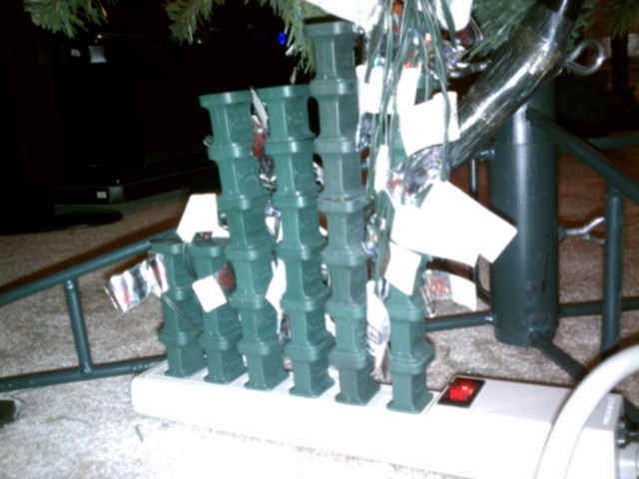
Community
Overwhelming amount
HTML5, CSS3, JavaScript
jQuery Plugins
HTML5 Polyfills
Notes:
jQuery Plugins: http://plugins.jquery.com/
Html5 PolyFills: https://github.com/Modernizr/Modernizr/wiki/HTML5-Cross-Browser-Polyfills

Slide 40


jQuery
jQuery is a fast and concise JavaScript Library that simplifies HTML document traversing, event handling, animating, and Ajax interactions for rapid web development. jQuery is designed to change the way that you write JavaScript.

Slide 41
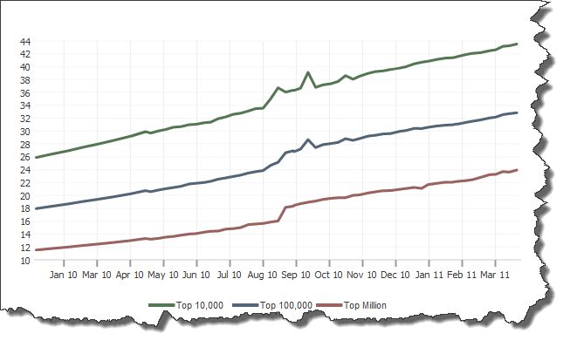
Most Popular?
19,915,538 and growing
Notes:
As of March 2011
http://trends.builtwith.com/javascript/Jquery

Slide 42
What’s Changed?
var checkedValue;
var elements = document.getElementsByTagName(‘input’);
for (var n = 0; n < elements.length; n++) {
if (elements[n].type == ‘radio’ &&
elements[n].name == ‘someRadioGroup’ &&
elements[n].checked) {
checkedValue = elements[n].value;
}
}
Notes:
Estimated Time: 1 Minute
Remember this? This was what it took to determine the value of a selected radio button before jQeury. What does it look like now?

Slide 43
What’s Changed?
var checkedValue = $(‘[name=“someRadioGroup”]
:checked’)
.val();
Notes:
Estimated Time: 1 Minute
Much simpler, no? That’s the goal of jQuery, to give you the full power of JavaScript through simple concepts and APIs that don’t clutter up your pages, and to enable you to accomplish common tasks faster with code that’s more readable and more maintainable.

Slide 44
Unobtrusive JavaScript
Script
( Behavior )
Html
( Structure )
Notes:
Similar to CSS, jQuery operates under the principle of creating clean separation of web elements. Rather than style and structure, as with CSS, jQuery works under the principle of “Unobtrusive JavaScript,” which encourages the separation of behavior and structure. As with CSS, you should put as little script in your Html pages, and certainly not on elements themselves.

Slide 45
jQuery in your website
jQuery.com
Self-host
CDN
Both!
Notes:
Estimated Time: 2 minutes
Talking Points:
You can choose to self host files - this is including jQuery in the scripts folder in Visual Studio.
Can also just include jQuery from a CDN - simply change the script reference to point to jQuery on the CDN
Can be faster loading and client browser may already have jQuery file cached
Be careful! If the CDN goes down your site may also go down.
You can also use the CDN and back that up with your local version :: We’ll demo that later
Forms ::
Source version is human readable.
Always include the minified version for your production code.

Slide 46
jQuery Fundamentals

Slide 47
jQuery :: Find and Do
1) Find Something
2) Do Something
Example
$(“#something”).hide();
<div id=“something”></div>
Notes:
Estimated Time: 2 minutes
Talking Points:
jQuery you typically find something, then do something with what you found.
Syntax for finding stuff is the same as the syntax used in CSS to apply styles.
Once something is selected, there are many different jQuery methods to do things.

Slide 48
The Selector
“p a”
“tr:even”
Notes:
Estimated Time: 1 Minute
If you spend any time around jQuery, you’ll hear the term “selector” thrown around. A selector in jQuery is simply a string that is passed into the jQuery function that identifies a single or set of DOM elements that should be selected from the page. jQuery selectors use the same selector syntax that CSS uses, which you should already be familiar with. In this example, we’re specifying all links within paragraph tags (“p a”) and in the second, all even table rows in a table (“tr:even”).

Slide 49
The jQuery Function
jQuery(“p a”)
$(“p a”)
Notes:
Estimated Time: 1 Minutes
The $() Function (an alias for the jQuery() function) returns a special JavaScript Object (called a jQuery object) containing an array of the DOM elements that match the selector, in the order in which they are defined in the document. This object contains several predefined methods that can act on the collected group of elements (show, hide, click, etc). This construct is called a wrapper (or wrapped set) because is wraps the collected elements with extended functionality.

Slide 50
Chaining
$(‘tr:odd’)
.addClass(‘odd’)
.click( function () {
alert(‘you clicked a row!’);
});
Notes:
Estimated Time: 3 minutes
Talking Points:
With jQuery many methods allow chaining.
Chaining is where you can continue to “chain” on methods one after another. You’re able to do this because many built-in jQuery wrapper methods (hide, show, click, addClass, etc.) return the same group of elements after each operations. On the jQuery API site (api.jquery.com), methods that chain return the jQuery object (the special wrapper object).
As an example, the addClass method will add the class ‘odd’ in the code above, and then return the jQuery collection it was given. This is why we can immediately chain on the “click” event
Click then operates on the odd rows by adding a click handler to each of them.

Slide 51
Stack Architecture
$(‘body’) // [body]
.find(‘p’) // [p, p, p] > [body]
.find(‘a’) // [a, a] > [p, p, p] > [body]
.addClass(‘foo’)
.end() // [p, p, p] > [body]
.end() // [body]
Notes:
Estimated Time: 3 minutes
Talking Points:
Some jQuery methods chain, but they return a whole new collection of elements. ‘Find’ and ‘Filter’ are two examples.
jQuery holds on to the previous collections, essentially creating a stack (last in first out) set to store them.
Methods like Find and Filter create a new collection which is added to stack. older collections are pushed further ‘downward’ on the stack
You can get a previous collection that was placed on the stack by using the end() method.

Slide 52
Chaining
$(‘tr’)
.filter(‘:odd’)
.addClass(‘myOddClass’)
.end()
.filter(‘:even’)
.addClass(‘myEvenClass’);
Notes:
Estimated Time: 2 minutes
Talking Points:
This is a popular use that shows both chaining and the stack architecture.
We first select all rows
We then filter that selection down to only the odd rows (the odd rows are placed on the top of the stack, and the ‘all rows’ collection is now ‘pushed downward’)
We add a class to the odd rows
We call end, which throws away our odd rows collection and grabs the next element in the stack (‘all rows’ collection)
We then filter to find even rows (again the stack behavior would occur)
We add a class to the even rows

Slide 53
Chain Breakers
//Getters vs. Setters
$(...).html(‘Hello world’).addClass(‘hello’)
// Non breaking
var html = $(...).html().addClass(‘hello’)
// Breaking, html() returns a string.
// addClass method is undefined on a string
Notes:
Estimated Time: 4 minutes
Talking Points:
Not all methods can be chained.
Some methods can operate as “getters”, which return an string.
Example: calling .html() with no parameters gets the HTML inside an element as a string. You can’t chain after that as you now have a string.
calling .html() with a string as the first parameter acts as a setter - which once the HTML is set, then the jQuery collection IS returned. You can then continue to chain.
Visual Studio 2010 Intellisense can help when figuring out whether or not you can chain!
You can also find out whether or not a methods chains by looking at api.jquery.com. If the method returns “jQuery” on the api site, then you know it can be chained.

Slide 54
Utility Functions
var trimmedString =
$.trim(someString);
Notes:
Estimated Time: 1 Minutes
Wrapping elements to be operated on is one of the most frequent uses of jQuerys $() function, but it’s not it’s only capability. The jQuery function can also serve as the namespace prefix for a handful of general utility functions. The above code can also be re-written as jQuery.trim() and perform the same function. The $ in this case is just a namespace prefix that provides access to general functions that don’t require the use of a pre-existing jQuery wrapped set to be utilized. The types of operations supported by utility functions include:
String manipulation
Filtering, sorting and managing arrays
Working with data
Parsing json data
Dynamically loading scripts
And many more!

Slide 55
Document Ready Handler
$(document).ready(function(){
// Your code here
});
Notes:
Estimated Time: 2 Minutes
The first thing that most Javascript programmers end up doing is adding some code to their program, similar to this:
window.onload = function(){ alert("welcome"); }
Inside of which is the code that you want to run right when the page is loaded.
Problematically, however, the Javascript code isn't run until all images are finished downloading (this includes banner ads). The reason for using window.onload in the first place is that the HTML 'document' isn't finished loading yet, when you first try to run your code.
To circumvent both problems, jQuery has a simple statement that checks the document and waits until it's ready to be manipulated, known as the ready event: (Same as code on slide)
$(document).ready(function(){ // Your code here });

Slide 56
DOM Manipulation
jQuery can create new elements
Still selecting something (brand new), then doing something.
$(‘<ul><li>Hi</li><li>Bye</li></ul>’)
.appendTo(‘body’);
Notes:
Estimated Time: 2 minutes
Talking Points:
You can create HTML elements on the fly with jQuery very easily, and then take action (such as adding that new element to the page).

Slide 57
jQuery Events
// Binding an event
function() myClickHandler {
// event handling code
$(this).css(‘color’, ‘red’);
};
$('a.tab').click(myClickHandler);
Notes:
Estimated Time: 2 minutes
Talking Points:
With jQuery binding to events is very easy. We can specify a click handler for example by using the click method.
The above example will bind the “myClickHandler” function to all anchors with a class of tab

Slide 58
jQuery Events
// Binding an event
$('a.tab').click( function() {
// event handling code
$(this).css(‘color’, ‘red’);
});
Notes:
Estimated Time: 3 minutes
Talking Points:
In JavaScript functions can be passed as parameter.
Functions in JavaScript do not have to have a name.
This is the same exact functionality as the last slide, except we simply declare the function inline as the first parameter of the click method.
This is important because in the previous example we polluted the global scope with a new function name, which was and can be dangerous as someone could overwrite your function with their own accidentally.

Slide 59
jQuery Fundamentals
Demonstration
Notes:
Use the Demo Script for jQuery Fundamentals

Slide 60
jQuery Ajax
Core Method
$.ajax();
Shortcut Methods
$.get(), $.post()
$.getJSON, $(...).load()
Notes:
Estimated Time: 3 minutes
Talking Points:
jQuery.ajax() is the core method - the shortcut methods use it ‘under the hood’. Thus it can do everything.
$.get() and $.post() set a single parameter - the type of HTTP Action that will occur (POST or GET)
$.getJSON will use the get HTTP action and will inform the server to send JSON back
$(...).load() will get HTML from the server and load it into whatever you have selected. Super simple! (more on next slide)
Note that there is no selection going on (except .load()). With certain jQuery methods there isn’t a a logical reason to make a selection first - most Ajax methods fall into that category. So they fall into the same

Slide 61
jQuery Ajax - $.load()
With ASP.NET MVC, you can return a partial view and add it to the page with load:
$(‘#myContainer’)
.load(‘home/myHtmlSnippet’);
Notes:
Estimated Time: 3 minutes
Talking Points:
$(...).load() will get HTML from the server and load it into whatever you have selected.
You could have the ASP.NET MVC server render a partial view, and return that with load!
Note that the server should return a partial page only. If it returns a whole page, then we are going to have some invalid HTML!

Slide 62
jQuery Ajax - $.getJSON()
// Response
{“names”: [“Joe”, “Jim”, “Bob”]}
$.getJSON(‘my/page/route’, function(json) {
$(‘body’)
.append( json.names[0] ); });
Notes:
Estimated Time: 3 minutes
Talking Points:
With ASP.NET you can return a JSONResult, which would work in cooperation with jQuery getJSON
When JSON returns, it is treated as a javascript object (that is why it is so handy!!)
Again we see that jQuery expects a function and we can specify the function to use inline and never have to actually name the function

Slide 63
jQuery Ajax
Demonstration
Notes:
Use the Demo Script for jQuery Fundamentals

Slide 64
jQuery Templating

Slide 65
Template Syntax
var tmpl = "<li>${ dataItem }</li>“;

Slide 66
Template Syntax
<script id=“myTemplate" type="text/html">
<li>${ dataItem }</li>
</script>

Slide 67
Template Syntax
<script id="productsTemplate" type="text/html">
<div>
<img src="Content/ProductImages/${Picture}" class="productImage" />
<span class="productName">${Name}</span>
Price: ${formatPrice(Price)}
<img data-pk="${Id}" src="Content/AddCart.png"
alt="Add to Cart" class="addCart" />
</div>
</script>

Slide 68
.render()
<script id=“myTemplate" type="text/html">
<li>${ dataItem }</li>
</script>
$("#myTemplate")
.render( dataObject )
.appendTo("ul");
<ul>
<li>foo</li>
</ul>

Slide 69
.render()
<script id=“myTemplate" type="text/html">
<li>${ dataItem }</li>
</script>
$("#myTemplate")
.render( arrayOfDataObjects )
.appendTo("ul");
<ul>
<li>foo_0</li>
<li>foo_1</li>
</ul>

Slide 70
jQuery Templating
Demonstration
Notes:
Use the demo script for adding jQuery Templating to the MVC Music Store Application

Slide 71
Extending jQuery Yourself
$.fn.disable = function() {
return this.each(function() {
if (this.disabled === null)
this.disabled = true;
});
}
$(“#myButton”).disable();
Notes:
Estimated Time: Two Minutes
jQuery contains a bevy of useful funcitons that we’ll reuse again and again, but no library can anticipate all of our needs. As such, jQuery was designed to enable you to easy extend core functionality and add your own. It’s possible to just write our own old-school style javascript functions as well, but extending jQuery allows us to use the powerful features jQuery provides, especially in the realm of element selection.
As an example, we’ve created a custom function above to disable a group of form elements. $.fn.disable means that we’re extendint the $ wrapper with a method named disable. Inside that function, the “this” keyword is the collection of wrapped DOM elements to be operated on. Then each() is called to operate over each element in the collection. Inside this block, the “this” keyword is a reference to the specific DOM element we’re operating on. Finally, we retuen the result of each so that our method will support chaining.

Slide 72
Extending jQuery With Plugins
$('ul:last li.active').qtip({
content: 'active list element', show: 'mouseover',
hide: 'mouseout'
});
Notes:
Estimated Time: 1 Minute
In addition to utilizing your own functions, you can also utilize any of countless plugins that provide custom jQuery functionality to your site. A Plugin in jQuery is just a JavaScript file that you include in your site. The file for that plugin will then Extend jQuery using the $.fn syntax covered in the last slide, and those functions are available for you to use.
The example above uses qTip (http://cragisworks.com/projects/qtip/demos/effecs/modal) to select the array od all li elements with the class “active,” and which are children of the last ui element on the page. Then the qTip function is called to place a tooltip-like hover box over each item that will show on the mouseover event, and hide itself on the mouseout event.

Slide 73
jQuery UI
Effects
Draggable, Droppable, Resizable, Selectable, Sortable
Interactions
Show & Hide additions, Color Animation, Easings
Widgets
Accordian, Autocomplete, Button, Datepicker, Dialog, Progressbar, Slider, Tabs
Notes:
Estimated Time: 2 minutes
jQuery UI is an official extension to the jQuery core library (and a separate js file and related styles), and is aimed at providing extended user interface capabilities to jQuery-enabled web application pages. The jQuery UI library provides us with a fair number of generally desired extended features or gives us higher-level building blocks to create them ourselves.
Unlike jQuery Core, jQuery UI is a confederation of loosely-coupled elements. The elements fall into 3 different categories, Effects, Interactions and Widgets.
Interactions and Widgets make heavy user of CSS to theme the visible elements, so downloading the jQeury UI files will also include a style sheet and images that match a style (either canned or that you create youself)

Slide 74
jQuery UI
Everything is themeable!
Adding most widgets is simple:
$(‘input:text.date’).datepicker()
Notes:
Estimated Time: 1 minutes

Slide 75
Jquery UI & Plugins
Demonstration
Notes:
Use the demo script for adding jQuery UI to the MVC Music Store

Slide 76
Microsoft Contributing to jQuery
Open, transparent and collaborative
In the spirit of jQuery community
Specification, Proposals on jQuery Forums
Prototypes as Plugins in Github
Cool Stuff = Templating, Script Loader, Data-linking
jQuery Core
Cool stuff ++
jQuery Core Team
Microsoft:
Proposal, Specification,
Prototype
ASP.NET Ajax Library
Cool Stuff
jQuery Plugins
Cool stuff
Notes:
Estimated Time: 2 minutes
Talking Points:
Microsoft is dedicated to assisting jQuery with open source contributions
What’s more, Microsoft ships jQuery with VS and includes the js files in the Scripts folder for WebForms and ASP.NET MVC applications.

Slide 77
jQuery Resources
jquery.com Downloading
api.jquery.com Documentation
forum.jquery.com Community
meetups.jquery.com Local Community
plugins.jquery.com Extending
jqueryui.com UI Widgets and Effects
Notes:
Estimated Time: 1 minute
Talking Points:
jQuery.com can be used to get started and get the code.
api.jQuery.com contains documentation for the entire core library. easy to search for topics and navigate to find information.
forum.jquery.com - dedicated jQuery forum where power users answer questions
jqueryui.com - jQuery UI has a separate documentation and examples site.

Slide 78
jQuery in action
Using jQuery and jQuery UI
demo

Slide 79
CoffeeScript
what is
Notes:
Use the Demo Script for jQuery Fundamentals

Slide 80
what?
CoffeeScript is a little language that compiles into JavaScript.
Underneath all those awkward braces and semicolons, JavaScript has always had a gorgeous object model at its heart. CoffeeScript is an attempt to expose the good parts of JavaScript in a simple way.
The golden rule of CoffeeScript is: "It's just JavaScript". The code compiles one-to-one into the equivalent JS, and there is no interpretation at runtime.

Slide 81
CoffeeScript
JavaScript
numbers = [1..10]
printNum = (number) ->
console.log "This is number #{number}"
printNum num for num in numbers
var num, numbers, printNum, _i, _len;
numbers = [1, 2, 3, 4, 5, 6, 7, 8, 9, 10];
printNum = function(number) {
return console.log("This is number " + number);
};
for (_i = 0, _len = numbers.length; _i < _len; _i++) {
num = numbers[_i];
printNum(num);
}
Notes:
Use the Demo Script for jQuery Fundamentals

Slide 82

what’s changed?

Slide 83
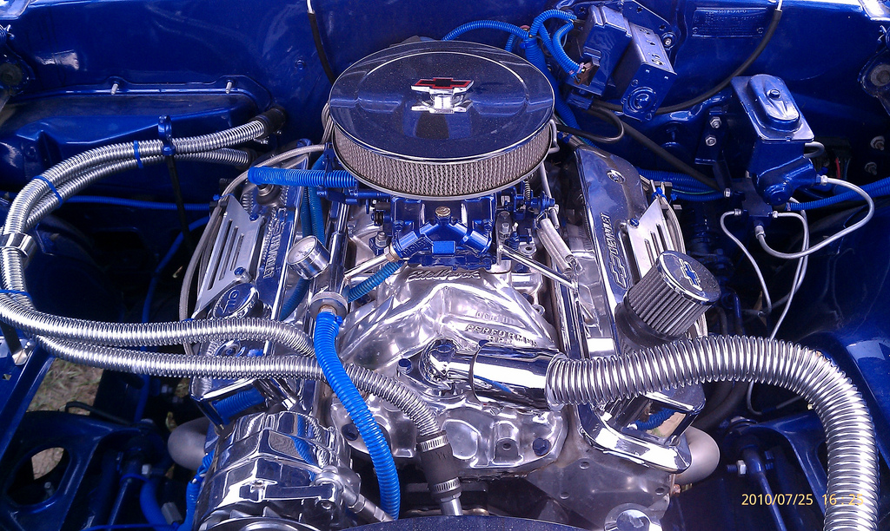
New JavaScript Engine

Slide 84
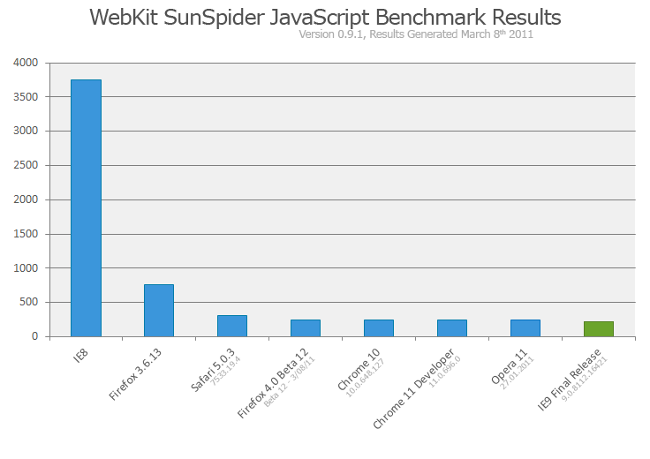
CodeName: Chakra
Notes:
IE9 introduced a new JavaScript Engine that was codenamed Chakra
Currently has the fastest benchmark times.
http://ie.microsoft.com/testdrive/Default.html
More details here: http://blogs.msdn.com/b/ie/archive/2010/03/18/the-new-javascript-engine-in-internet-explorer-9.aspx

Slide 85

ECMAScript 5
Became Standard In Dec 2009
First language change since 1999
Supported in IE9
Notes:
ECMA Script Support in IE9 - http://msdn.microsoft.com/en-us/ie/ff468705.aspx#_ECMAScript5
http://blogs.msdn.com/b/ie/archive/2010/07/16/how-ie9-platform-preview-feedback-changed-the-javascript-standard.aspx
http://blogs.msdn.com/b/ie/archive/2011/03/24/ie9-s-document-modes-and-javascript.aspx
http://www.ecma-international.org/publications/standards/Ecma-262.htm

Slide 86
ECMAScript 5 in Action
demo

Slide 87

wrap
Notes:
http://farm3.static.flickr.com/2412/1535004347_a24d2cb5aa_z.jpg?zz=1

Slide 88
MIX Sessions the sessions you should go see
Good JavaScript Habits for C# Developers
Elijah Manor
JavaScript Panel
Luke Hoban, Allen Wirfs-Brock, Tomasz Janczuk and Doug Crockford
Pragmatic JavaScript, jQuery & AJAX with ASP.NET
Damian Edwards
Reactive Extensions for JavaScript ( RxJS )
Bart De Smet

Slide 89
http endpoints
Beauty of the Web
http://www.beautyoftheweb.com/
IE Test Drive
http://IETestDrive.com
IE9 Developer Documentation
http://msdn.microsoft.com/en-us/ie/ff468705.aspx
Script Junkie
http://ScriptJunkie.com

Slide 90

© 2011 Microsoft Corporation. All rights reserved. Microsoft, Windows, Windows Vista and other product names are or may be registered trademarks and/or trademarks in the U.S. and/or other countries.
The information herein is for informational purposes only and represents the current view of Microsoft Corporation as of the date of this presentation. Because Microsoft must respond to changing market conditions, it should not be interpreted to be a commitment on the part of Microsoft, and Microsoft cannot guarantee the accuracy of any information provided after the date of this presentation. MICROSOFT MAKES NO WARRANTIES, EXPRESS, IMPLIED OR STATUTORY, AS TO THE INFORMATION IN THIS PRESENTATION.

Slide 91
appendix

Slide 92
People the people you stalk
Douglas Crockford
Elijah Manor @ElijahManor
Rey Bango @ReyBango
Paul Irish @Paul_Irish
Dave Ward @encosia
Notes:
Elijah Manor
Twitter: @elijahmanor
Site: http://ElijahManor.com
Douglas Crockford
Rey Bango
Twitter: @ReyBango
Site: http://blog.reybango.com
Paul Irish
Site: http://paulirish.com
Twitter: @Paul_Irish
Dave Ward
Twitter: @encosia
Site:

Slide 93
Videos the stuff you watch
David Crockford, JS The Good Parts
Paul Irish, 10 + 11 things he’s learned reading jQuery
PluralSight
TekPub
Notes:
PluralSight, http://Pluralsight.com
TekPub, http://TechPub.com
David Crockford, http://yuiblog.com/crockford/
http://paulirish.com/2010/10-things-i-learned-from-the-jquery-source/
http://paulirish.com/2011/11-more-things-i-learned-from-the-jquery-source/

Slide 94
Tools the stuff you use
jQuery
QUnit
jsMock
JSLint
Modenizr

Slide 95
Sites the http endpoint
Script Junkie
Enterprise jQuery
What To-Read To Get Up To Speed In JavaScript
Developer.Mozilla.org
Notes:
http://blog.reybango.com/2010/12/15/what-to-read-to-get-up-to-speed-in-javascript/
https://developer.mozilla.org/en/JavaScript/Guide

Slide 96
Publications the stuff you read
JavaScript The Good Parts
Eloquet JavaScript
JavaScript Patterns
jQuery in Action
Notes:
JavaScript The Good Parts, 9780596517748
jQuery In Action, 1935182323
JavaScript Patterns, 9780596806750
jQuery Cookbook, 9870596159771
jQuery Novice To Ninja, 9780980576856
Eloquent JavaScript, http://eloquentjavascript.net/

Slide 97
Stalk Me
http://ClarkSell.info
csell@microsoft.com

Slide 98
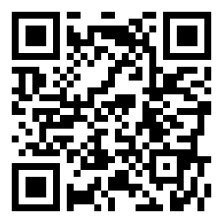
Resource Link Bundle:
http://on.csell.net/RebootYourJavaScript
Notes:
http://on.csell.net/RebootYourJavaScript

